Slide 1

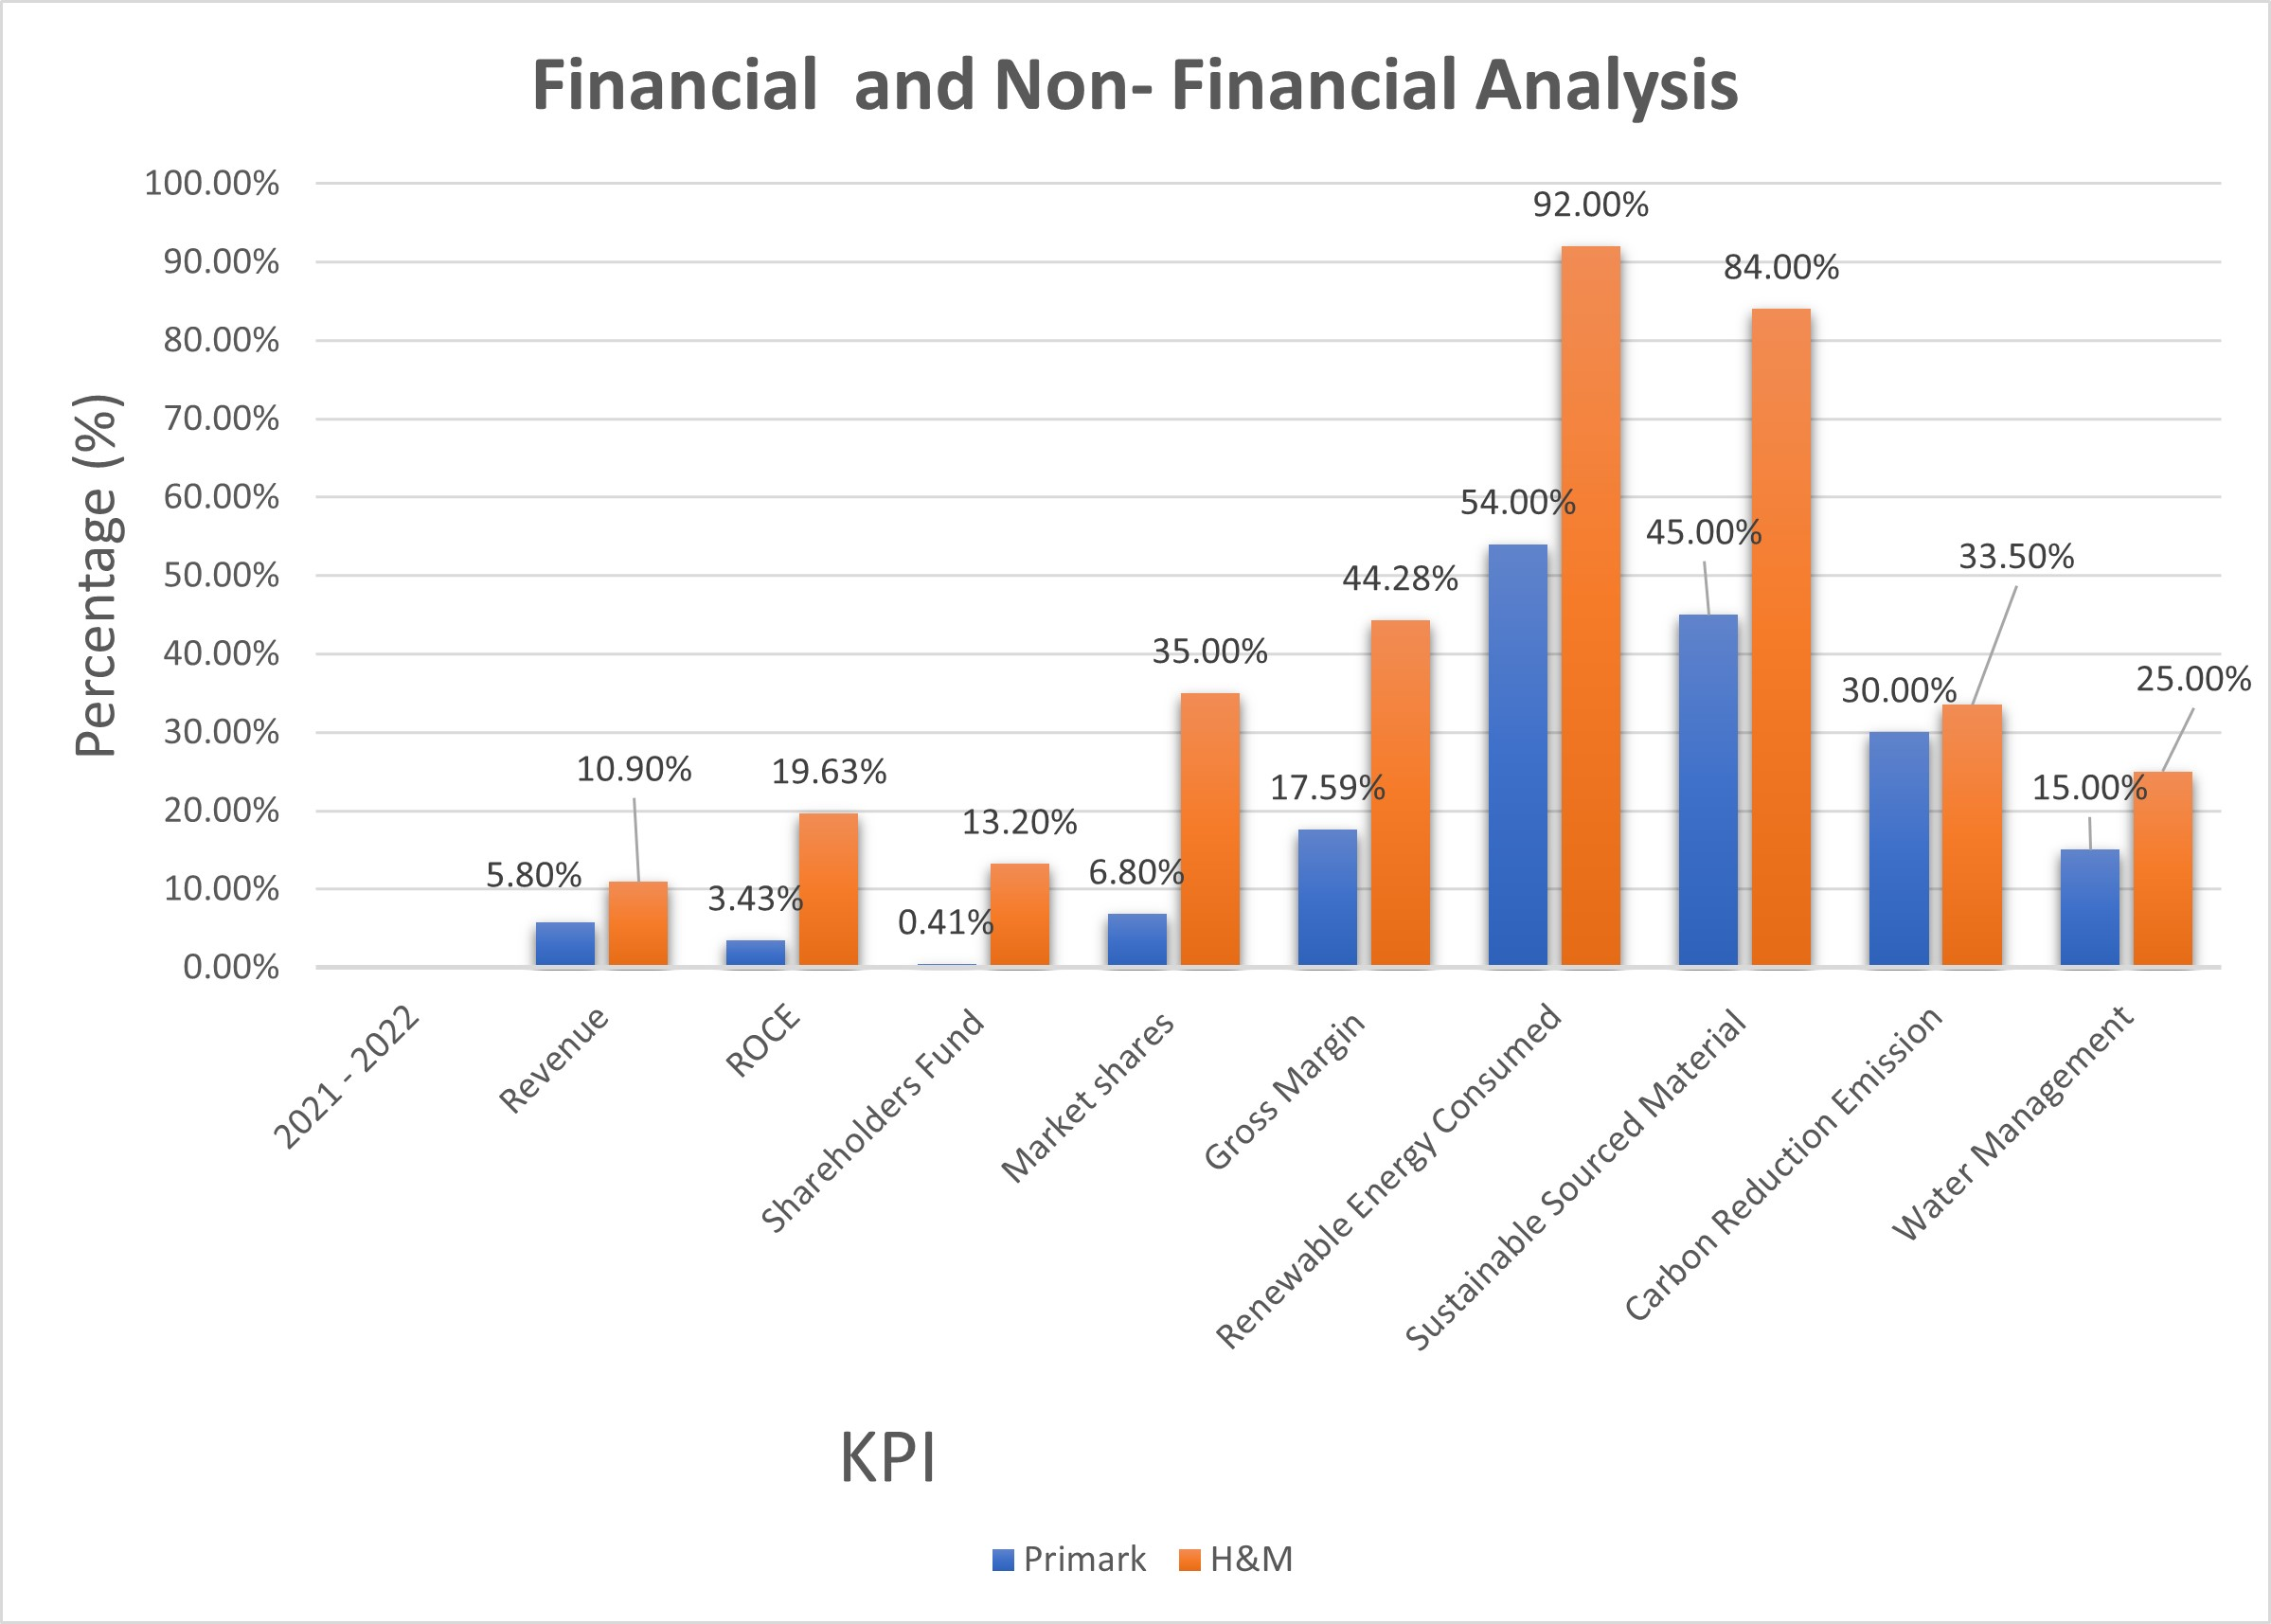
Benchmarking, Primark Ltd,
Benchmarking Subjects
Key Identified Gaps from the Benhcmarking
PRIMARK STORES LIMITED
London, England, Clothing, Footwear and Accessories
H&M London, England and Clothing, Accessories and footwear.
Financial: H&M has a higher Revenue of 10.91%, ROCE 19.63%, H&M has 35% market shares and shareholders fund of 13.2% .
Non -financial: H&M had 84% Sustainable sourced material, and Renewable energy consumed was 92%.
Aim and Approach
Visual Panels
The purpose is to determine Primark’s finacial and environmental performance of the company. A Balance Scoredcard approach was used in the benchmarking exercise to compare the peformances of both companies to improve the company performance and improve on supply chain sustainabilty strategy.
Sources of Data
Recommendations
Primark should invest in more sustainable sourced material to increase the trust of their customers because of environmental awareness. Customers now buy sustainably by looking at the company’s CSR- corporate social responsibility in terms of the company’s transparency and value on sustainability and working conditions of the employees. Primark revenue is low and based on the company's vision to expand globally- global strategy and e-commerce strategy needs to be implemented. Primark should increase the number of stores and engage in online sales to attract more customers to increase their sales.
A secondary data was sourced from FAME, both companies’ annual reports for the financial measures.
Non-Financial information was sourced from Primark, H&M and Statista websites.

